Slide 1


Used Hyundai Car Price
Regression
Project by:
pd16_075-Jitendrasingh Rao
pd16_268-Mayank Sinha
pd16_254 -Saurav Sagar Pandey
pd15_254-Akash kumar Shadangi

Slide 2
What is the Project ?

Slide 3

Introduction
We the students of Masai school were taught using various data analysis tools such as Excel, Advanced SQL, Python and also the Machine Learning models.
For implementing the same we have been given a project to create a ML model which can predict the sale price of the used Hyundai cars in UK
The Project mainly consist of 4 parts. They are:
Data familiarization
EDA
Model Selection
Presentation

Slide 4
But!
What does Regression mean ?

Slide 5
Regression Analysis
How it is helpful to the Project
Regression analysis is a set of statistical methods used for the estimation of relationships between a dependent variable and one or more independent variables.
It can be utilized to assess the strength of the relationship between variables and for modeling the future relationship between them.
Sale prices of the cars are also dependent on factors such as mileage,driven Miles, year of Manufacturing and many more.
As we read, Regression helps in finding relationships between variables these factors and the Price can be treated as variables and model can be made for prediction.

Slide 6
Let’s get started !

Slide 7


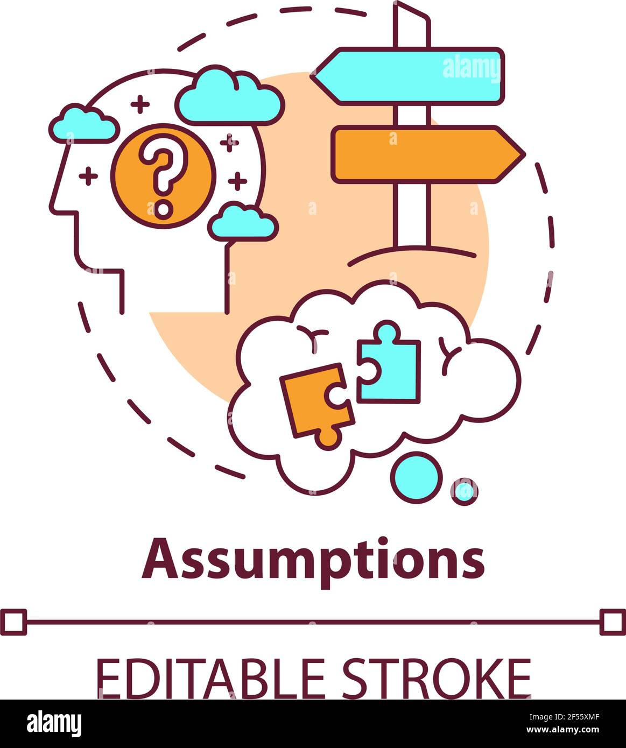
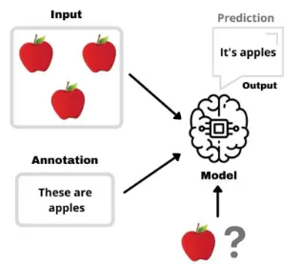

Challenges faced !
Time Management.
Right Interpretation of the Given Data
Making appropriate assumptions.
Creating the Right Model.
Making the Model useful in real life scenario

Slide 8

What we had ?

Slide 9
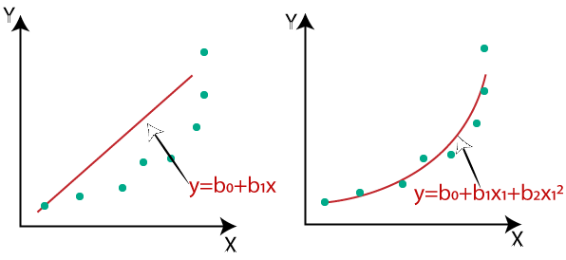
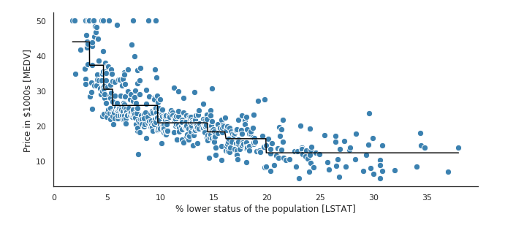
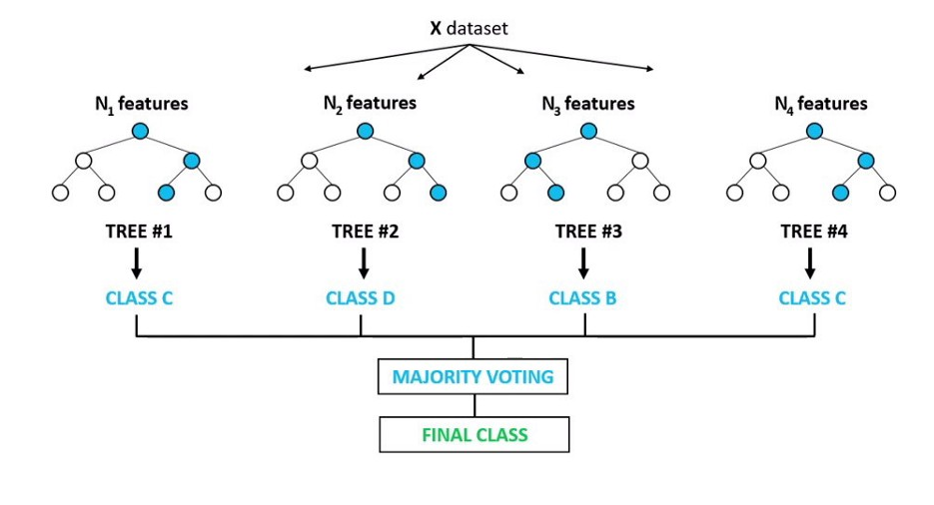
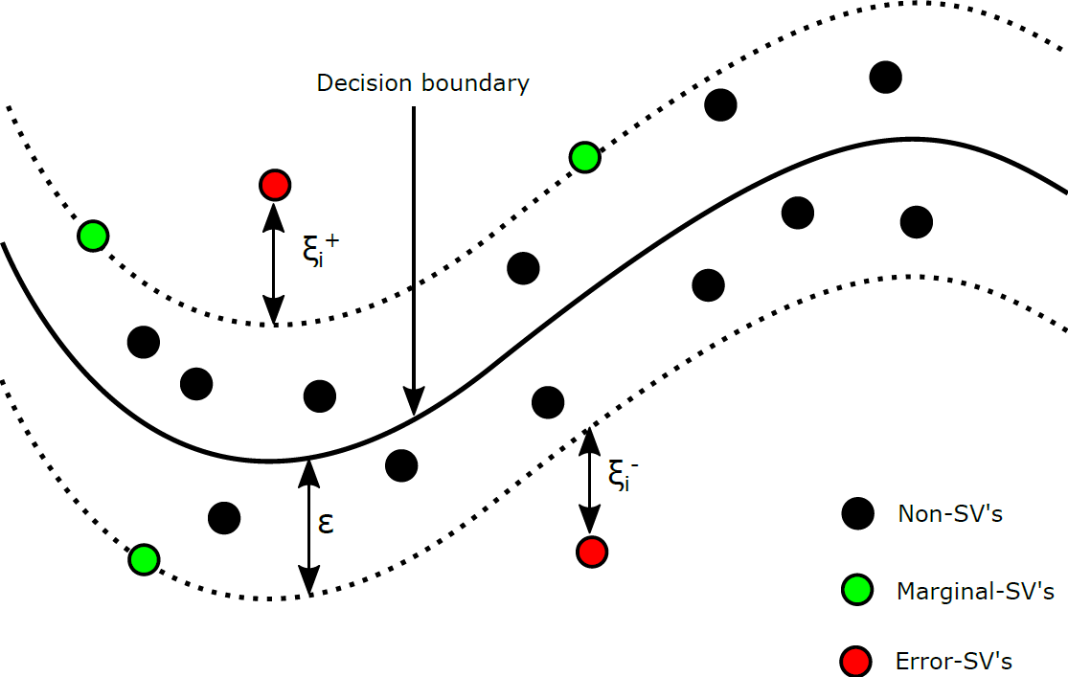
Machine Learning Models
Linear Regression
Polynomial Regression
Decision Tree Regression
Random Forest Regression
Support Vector Regression

Slide 10
Model Training and Selection
After overcoming the initial challenges, we have had the data ready for the model training and we all had a clear understanding of the features of the data.
Various models, such a Linear Regression, Polynomial Regression of degree 2 and 3, Decision Tree Regression, Random Forest Regression and Support Vector Regression, were trained.
The model were tested for their accuracy, overfitting and underfitting for training as well as testing data.
Finally based on the outcomes from all the models the best was selected.

Slide 11
Who got Selected ?

Slide 12
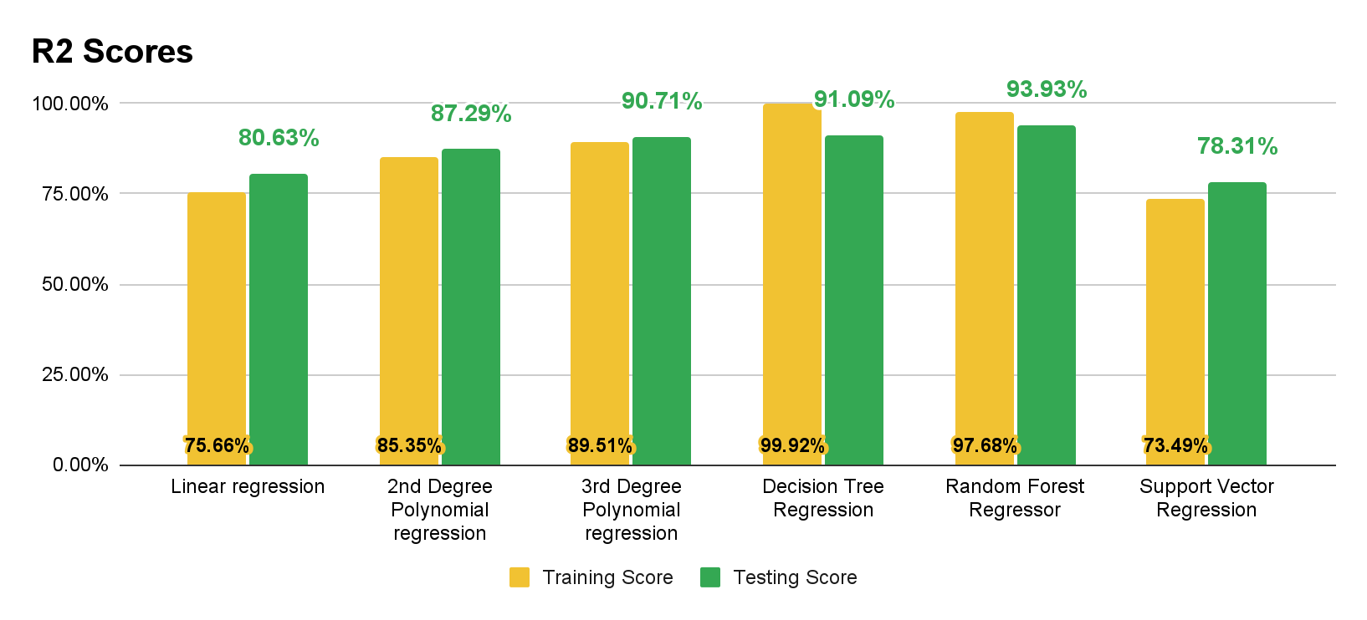
Model Outcomes !!!

Slide 13

Even though there was a tough spot between Decision Tree and Random Forest
Random Forest Regression
was selected for predictions

Slide 14
Takeaways and Insights

Slide 15
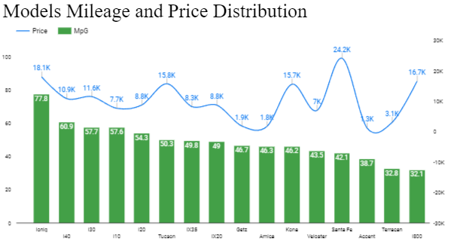
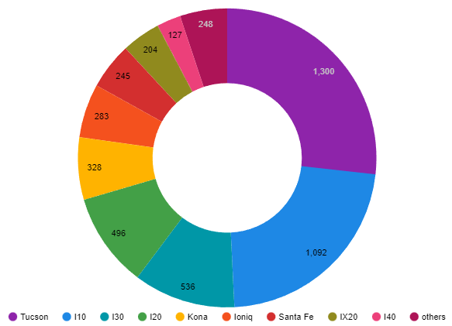
Models Mileage and Price Distribution
From the graph besides, it is clearly evident that all the cars have an comparable Mileage, however their Sale prices have a huge variations.
The potential reasons could be :
Better features for in some
More advertisements
Better User Ratings
Models Distribution
From the below mentioned one, we can see that majority of share is taken by only 4 models and this can potentially influence the model.
This became a critical thinking point while training the model and also while testing it was taken into consideration

Slide 16
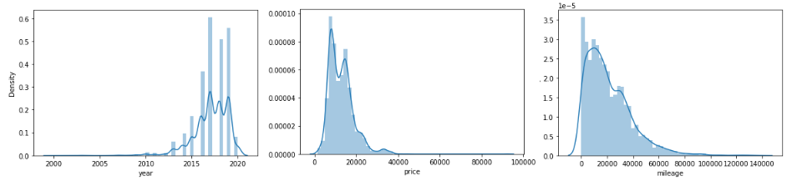
From the distribution of the Plots we have the following outcomes:
Cars on sale are majorly from past 5 years, possible reasons:
General tendency of people to have a car for 3 to 5 years
People are not much interested to buy cars that are used for more than 6 years
Sale prices are kept in specific range knowing the fact that customers might not be willing to pay high prices for a used car
Cars are not heavily used as the driven Miles are not high. this could be by 2 reasons:
People prefer public transport over personal vehicles
Frequently changing Cars

Slide 17
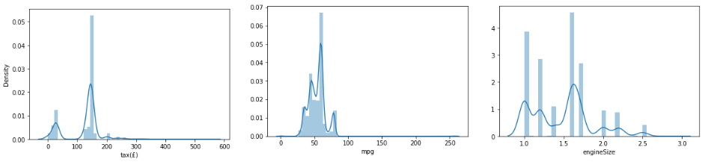
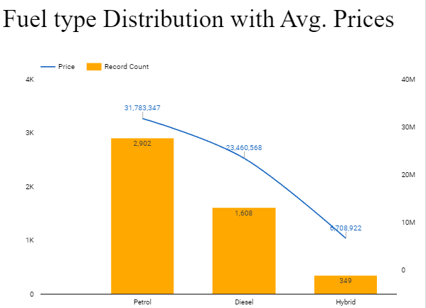
Taxes are having only 2 peaks as UK have specific Tax Structure which focuses on the years of manufacturing and total miles driven. Initially it was low but had a rise in the same in 2017
A general average of the cars is 65 miles per litre Gasoline
Engine sizes are generic and evenly distributed
From the Fuel Type Distribution
Undoubtedly the petrol variants are dominating in the data possible reason:
Ever rising fuel prices.
New options are available in market as electric, biodiesel, etc.
Hybrids are also there as mentioned before, people are hobbyis.

Slide 18


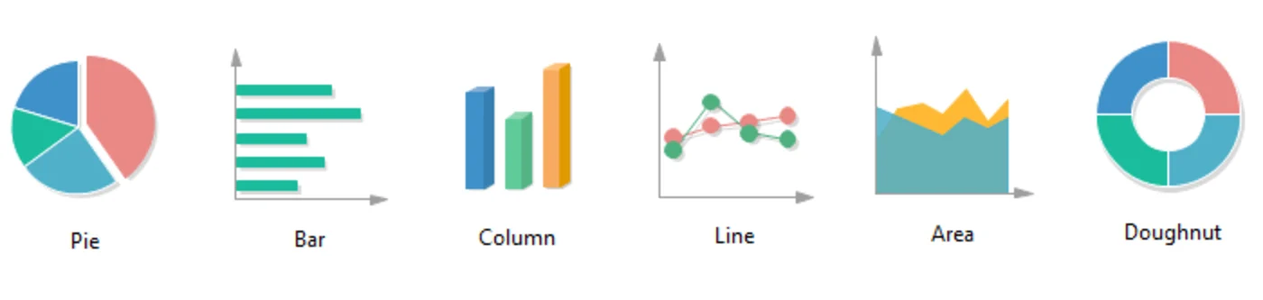
Let’s have a look on the
Dashboard
ML Model

Slide 19
Way Forward
The model selection was one part, to actually have an insight of the data, insight of models and their applications.
However the actual application of the project would be having the an actual function in place, which is matured enough to actually give the predictions for real world data.
Learnings from this project:
For better interpretation more and more data should be explored.
Better coordination and communication between team.
New tool exploration
Having all the things in place we see our self in a better position in machine learning and in general as well.

Slide 20
Thankyou

